Slide 1
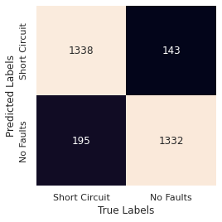
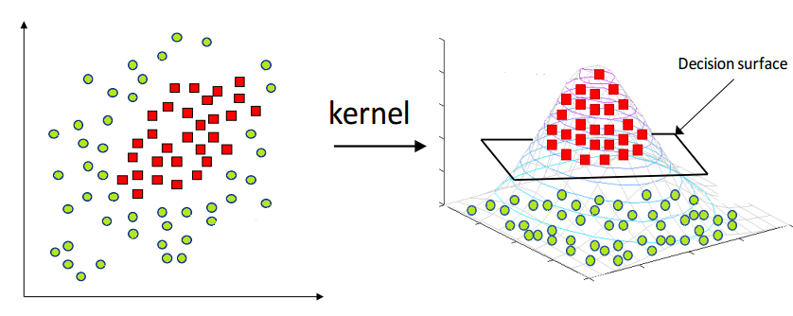
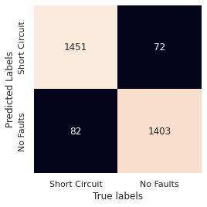
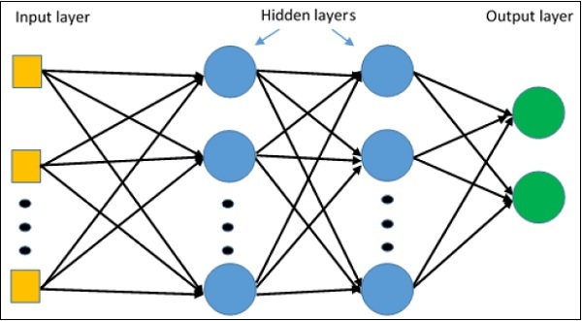
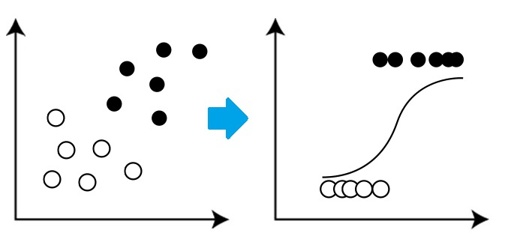
Quantum Machine Learning for Solar Panel Fault Detection
Trevor Irvin¹, Sameeksha Katoch², Andreas Spanias², Glen Uehara²
[1] Ira A. Fulton Schools of Engineering at Arizona State University [2] School of ECEE at Arizona State University
Dataset contains 10 features with 5 classifications: 4 faults and standard test conditions
Pre-process data (normalization, one-hot encoding, binary classification split, train/test split)
Train logistic regression, support vector machine, and neural network models
Adjust hyperparameters (epochs, solver, penalty, activation function, hidden layers)
Record results (accuracy, recall, precision, F-score)
Test results against quantum versions of these models
Logistic Regression
SVM
SVM:
Neural Network
Accuracies:
LR 88.76%
SVM 91.29%
NN 94.88%
NN:
LR:
Sensor Signal and Information Processing Center: http://sensip.asu.edu/nsf-ires-project
IRES project sponsored by NSF Award 1854273.
Notes:
Hello everyone, my name is Trevor, I’m from the IRES Cyprus program, and my project is Quantum Machine Learning for Solar Panel Fault Detection.
In order to maximize the efficiency of the power outputted by Solar Panels, it is necessary to detect and diagnose faults within a circuit of panels. This is because a faulty panel can cause neighboring panels to also experience reductions in power output. An effective method to solve this issue is using machine learning algorithms designed for the classification of faults. Additionally, quantum methods for these models are to be explored for their current efficacy.
In this project we took a solar array dataset containing 10 features with 5 classifications. These classifications included 4 faults including Shaded, Short Circuited, Degraded, and Soiled, with the final classification being standard conditions.
The data was normalized with the labels being converted to one-hot encoding for tests involving multi-classifcation and to ease future tests involving binary classification. For my tests, I decided to take the Short Circuit data and test it against the standard condition data. This was to reduce the data set and the computational load for future quantum tests.
The data was then trained on three classical models to obtain a baseline: logistic regression, a support vector machine, and a neural network.
Hyperparameters for each of these machines was adjusted in order to maximize accuracy when presented the test data.
Results, including accuracy and F-score were taken to measure the effectiveness of the models.
In my future research, these classical models will be compared to quantum models of the same type to measure their current effectiveness for classifying solar data.

